Slide 1
Digital Photography
Using the Elements and Principles in Photography

Slide 2
Elements : The composition’s individual parts Principles : The composition’s organizing ideas

Slide 3
Line
An element longer than it is wide.
Bourke-White

Slide 4
Line
An element longer than it is wide.
Bourke-White

Slide 5
Line
An element longer than it is wide.
Can suggest depth.
Can lead the eye
Eisenstaed

Slide 6
Line
An element longer than it is wide.
Can suggest depth.
Can lead the eye
Brassi

Slide 7
Line
An element longer than it is wide.
Can suggest depth.
Can lead the eye
Can create pattern
Modotti

Slide 8
Line
An element longer than it is wide.
Can suggest depth.
Can lead the eye
Can create pattern
Modotti

Slide 9
Shape
Shape is 2-Dimensional; flat
Created by strong contrast
Nagy

Slide 10
Shape
Shape is 2-Dimensional; flat
Created by strong contrast
Elements or objects grouped together
Atget

Slide 11
Shape
Shape is 2-Dimensional; flat
Created by strong contrast
Elements or objects grouped together
Adams Sr.

Slide 12
Form
Form is 3-Dimensional; Not flat
Created by many different values
Man Ray

Slide 13
Form
Form is 3-Dimensional; Not flat
Created by many different values
Weston

Slide 14
Value
Lightness or darkness or a surface

Slide 15
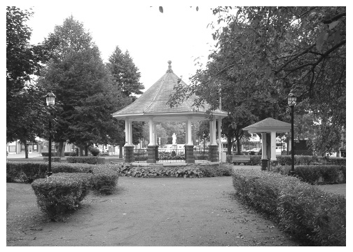
A good black and white print has…
Black values with detail
White values with detail
And a variety of grays in-between

Slide 16
Underexposed
Too light
White values lost detail

Slide 17
Over-exposed
Too dark
Dark values lost detail

Slide 18
Color
Hue (pure color)
Value (lightened or darkened color)
Saturation (intense or dulled color)

Slide 19
Color
Difference in color can direct the audience’s attention to one area. This different color is called an accent color.
Carroll

Slide 20
Color
An accent color can direct the audience’s attention to one area..
Color can provide symbolism
Rice

Slide 21
Color
An accent color can direct the audience’s attention to one area.
Color can provide symbolism
Wright

Slide 22
Color
Difference in color can direct the audience’s attention to one area.
Color can provide symbolism
Colors can calm
Lane

Slide 23
Color
Difference in color can direct the audience’s attention to one area.
Color can provide symbolism
Colors can excite
Crumb

Slide 24
Texture
Capturing the way something might feel through an image.

Slide 25
Balance
Creating equilibrium between visual elements.

Slide 26
Balance: Symmetry
Imagine a vertical line that runs through the middle of the picture.
Symmetrical images are like mirror reflections on either side of that line.

Slide 27
Balance: Symmetry
The main subject is usually centered.

Slide 28
Balance: Symmetry
Symmetrical pictures are more formal and calm.

Slide 29
Balance: Asymmetry
Asymmetrical pictures do not rely on a vertical line.
The subject is NOT centered.

Slide 30
Balance: Asymmetry
Asymmetrical pictures do not rely on a vertical line.
The subject is NOT centered.
Asymmetrical images are informal and more exciting.

Slide 31
Rule of Thirds
This is a guide to balance asymmetrical images.
Imagine a tic-tac-toe board over your view finder.

Slide 32
Rule of Thirds
The center of focus in your image; the most important subject, is placed in 1/3rd of the frame..

Slide 33
Rule of Thirds
The center of focus in your image; the most important subject, is placed in 1/3rd of the frame.
People’s eyes should be about 1/3 down.

Slide 34
Rule of Thirds
Horizons in landscapes should be either 1/3 up or 1/3 down, approximately.
Never in the middle.

Slide 35
Pattern
Repeating elements

Slide 36
Rhythm
Repeating elements create a sense of movement and tempo
The photographer created a flowing rhythm.

Slide 37
Rhythm
Repeating elements create a sense of tempo
Muybridge created literal rhythm.

Slide 38
Emphasis
Making one aspect of your photo stand out to capture the audience’s attention.
Difference

Slide 39
Emphasis
Making one aspect of your photo stand out to capture the audience’s attention.
Difference

Slide 40
Emphasis
Making one aspect of your photo stand out to capture the audience’s attention.
Difference
Framing – using an element in the foreground or background to surround your subject.

Slide 41
Emphasis
Making one aspect of your photo stand out to capture the audience’s attention.
Difference
Framing – using an element in the foreground or background to surround your subject.

Slide 42
Emphasis
Making one aspect of your photo stand out to capture the audience’s attention.
Difference
Framing – using an element in the foreground or background to surround your subject.

Slide 43
Emphasis
Making one aspect of your photo stand out to capture the audience’s attention.
Difference
Framing – using an element in the foreground or background to surround your subject.

Slide 44
Unity
Making sure everything in your image looks like it belongs together.
Nothing looks out of place.

Slide 45
Unity
Repeating elements creates a sense of unity.
Even though the colors in this photo are very different, the subject is similar, therefore creating a sense of unity.

